Slide 1
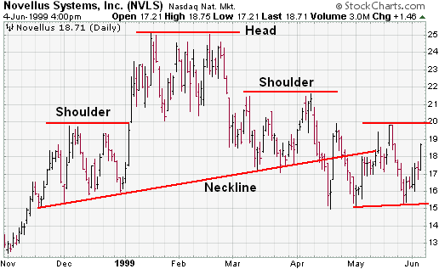
2 months before expiration:
Which it’s best time (and price) to trade options?

Slide 2
The data
35 years of daily and weekly S&P 500 index data (all available for free)
25 years of daily data on options on S&P 500 (the most recent are for free)
Focus on the last month of each quarter (most important expiration)
140 quarters (samples) to train the model
Some simple indicators (mostly moving averages) and some proprietary indicators
So, the model once trained can work with data available on the web for free (Google Finance, Yahoo Finance, …

Slide 3
The Model
4 concurrent regression models:
Guess the price upper limit
Guess the price lower limit
Guess the extent of the price movement
Guess the central point of the price movement
Any intersection of these two ranges is our target

Slide 4
The fifth element…
One indicator based upon main options open interests telling us how the current price level “challenges” the exposure by most important investors, those able to “push” and “pull” the market, to some extent (mostly when close to options expirations).
When the price is out of our intersection, and this indicator points to the intersection, that’s the right time to trade options.
It doesn’t happens for each quarter (about 50%), but when it happens you always take home all your expected profit
Samples: March 9th 2009, June 8th 2015,…

Slide 5
And it works also on any liquid exchange traded asset! (single stocks, currencies, commodities,…)

